Slide 1
Presentation
The Russian Federation and Germany: bilateral relations.
Done by: Rasulov Osimzhon

Slide 2
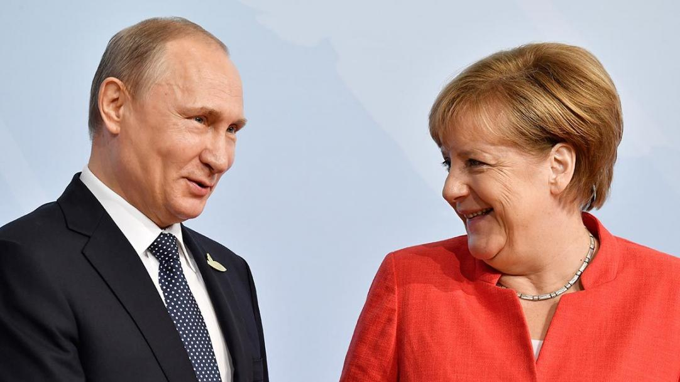
Mr.Putin and Angela Merkel personal relationship

Slide 3
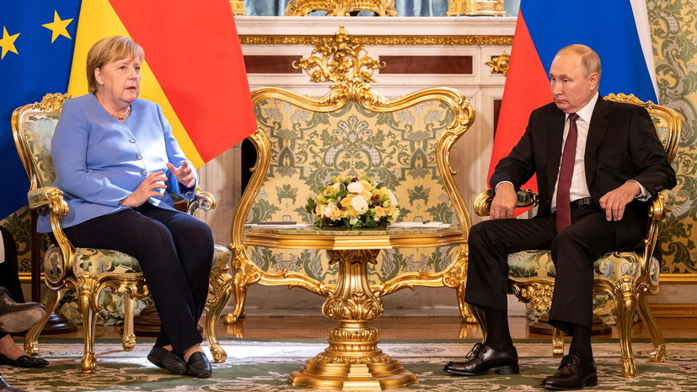
Political views and relations of Russia and Germany
Relations between Germany and Russia are wide-ranging. The two countries’ political relations are overshadowed by Russia’s violations of fundamental principles enshrined in international law in the course of its annexation of Crimea and actions in eastern Ukraine.

Slide 5
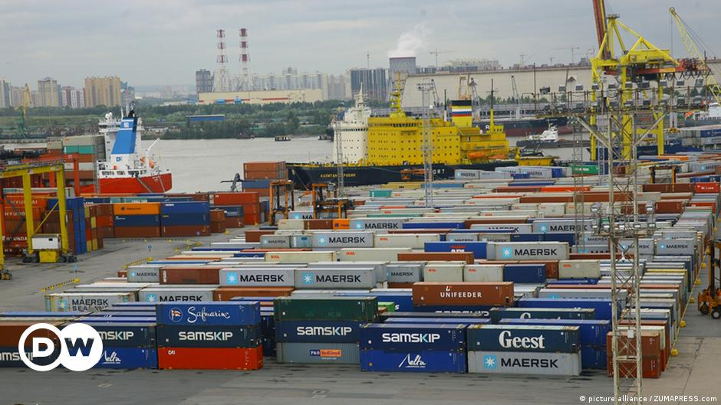
Germany is Russia’s largest trade partner after China.

