Slide 1
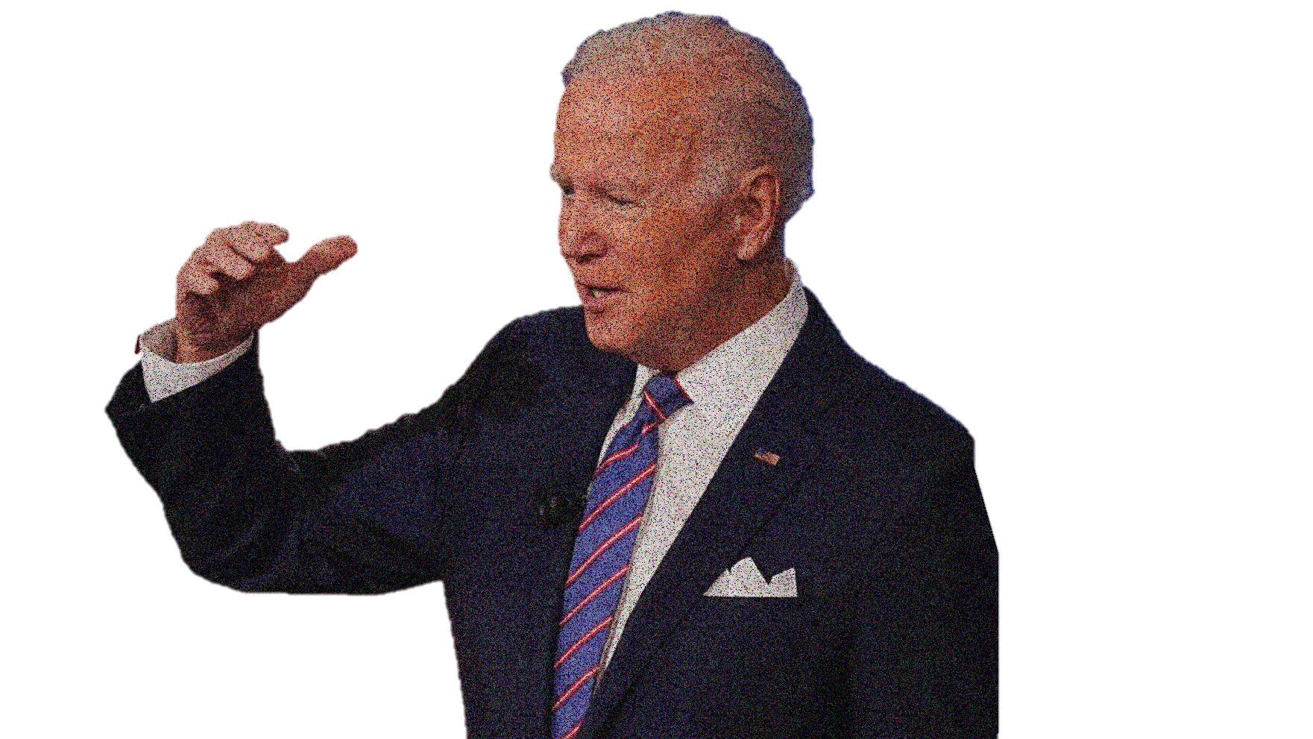
IS
AMERICA
BACK?

Slide 2
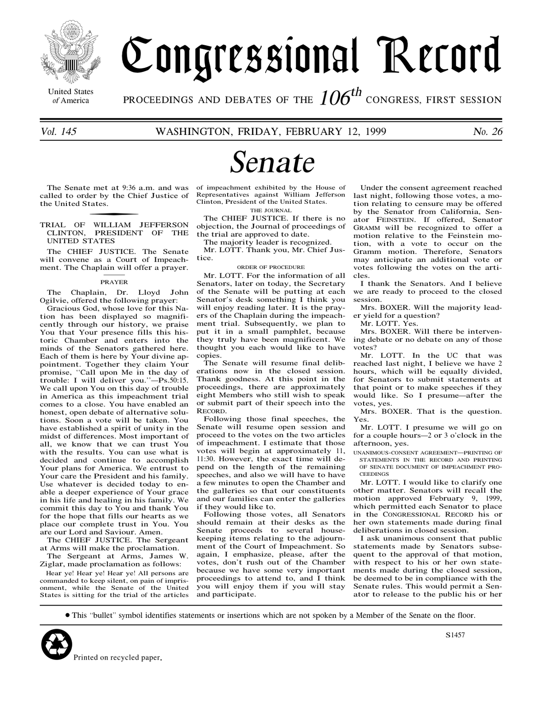
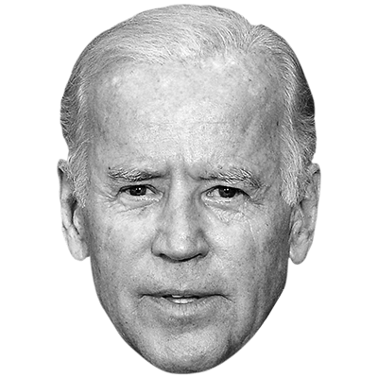
Concept of «New Europe»
America is back
Supranational level
National level
Supranational level
National level

