Slide 1
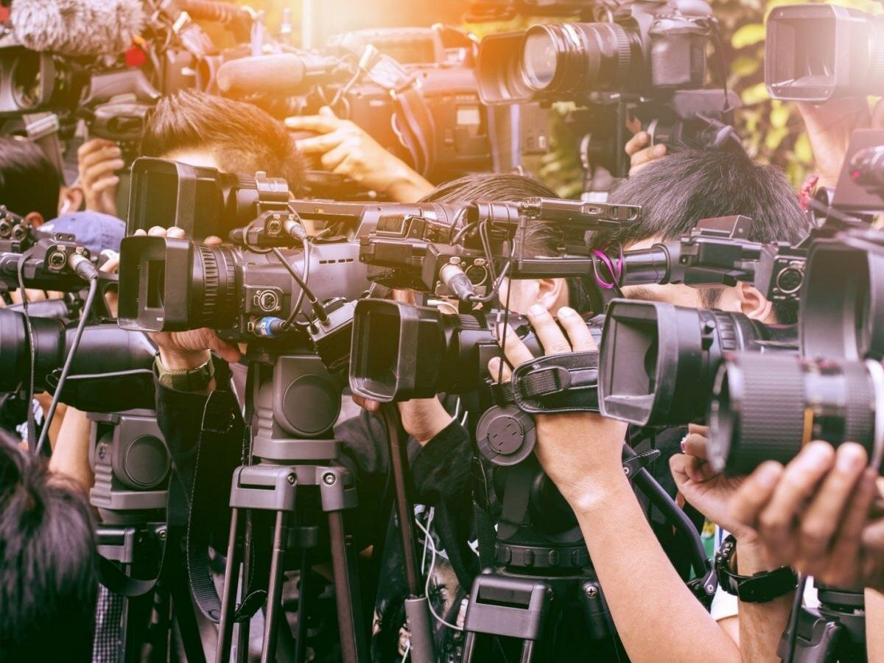
The image of Arab women in the mass media
Made by Marina Mkrtchyan (Faculty of International Relations, Political and Area Studies, Master’s Degree Course, Second Year)

Slide 2
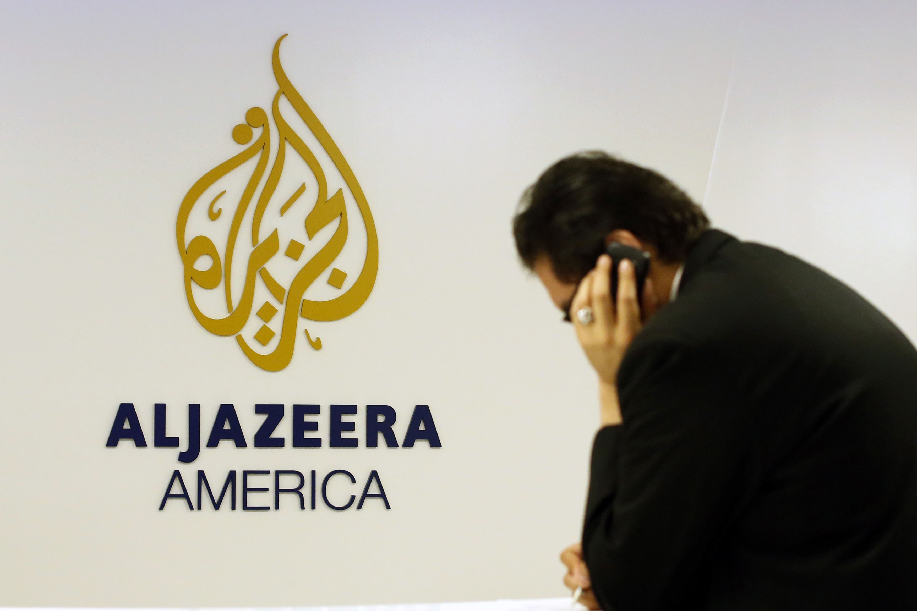

Slide 3
People could take part regardless of their age. It was only necessary to call. The program aired on Mondays and the episode was shown twice a week on TV. The show was classified as one of the most popular programs on Al Jazeera.

Slide 4
While women were mostly portrayed in a family context as a good wife, the programme also featured women outside of that context, such as a political activist, a candidate or a laborer, as well as victims of societal norms and cultural and religious misconceptions.

Slide 5
Unlike the «Only Women» programme, women tell their stories, sufferings or defend their rights in the form of documentary chronicles. The programme showed the views and experiences of these women how they spontaneously move in front of cameras, filmed them at home, at work, with families or alone. The video editing was combined with very skillful sound effects, especially the local music of the country in which the woman lived ( it helped the audience to penetrate to cultural and social origins).

Slide 6
Thank you for your attention!

