Slide 1
The attempt of an Organisasi Papua Merdeka (Free Papua Movement) to gain international support
Jahro D.A.
Khalilova L.A.

Slide 2
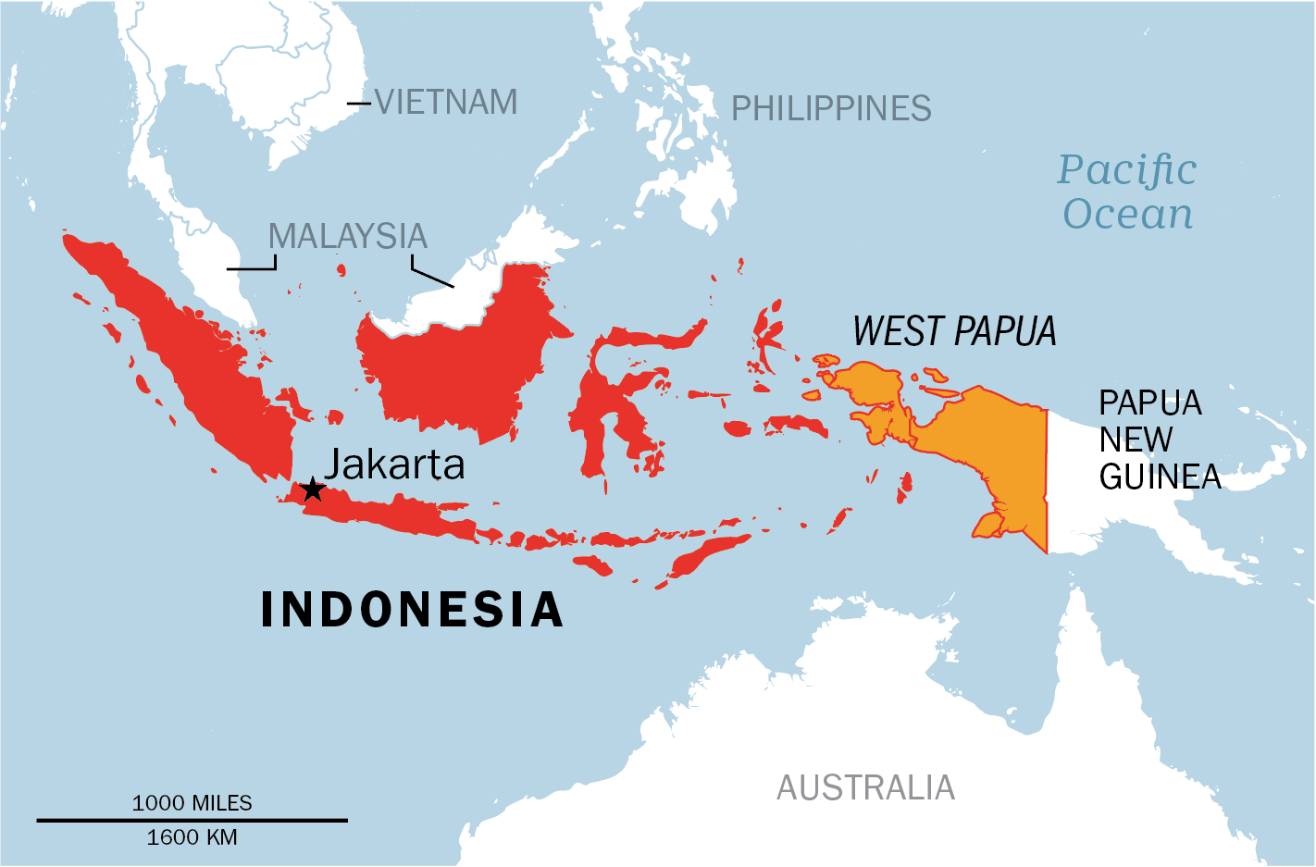

Slide 3
About Organisasi Papua Merdeka ( Free Papua Movement)
The Free Papua Movement are begun after Netherlands New Guinea was transferred to Indonesia under the 1962 New York Agreement
The regime’s implementation of the New York agreement made minimal attempts to consult indigenous Papuans’ views, thus limiting their options for self-determination
Since its beginnings in 1965, the Free Papua Movement has been a largely peaceful movement. However, the movement’s military wing, the Tentara Pembebasan Nasional Papua Barat (TPNPB), continues to bear arms

Slide 4
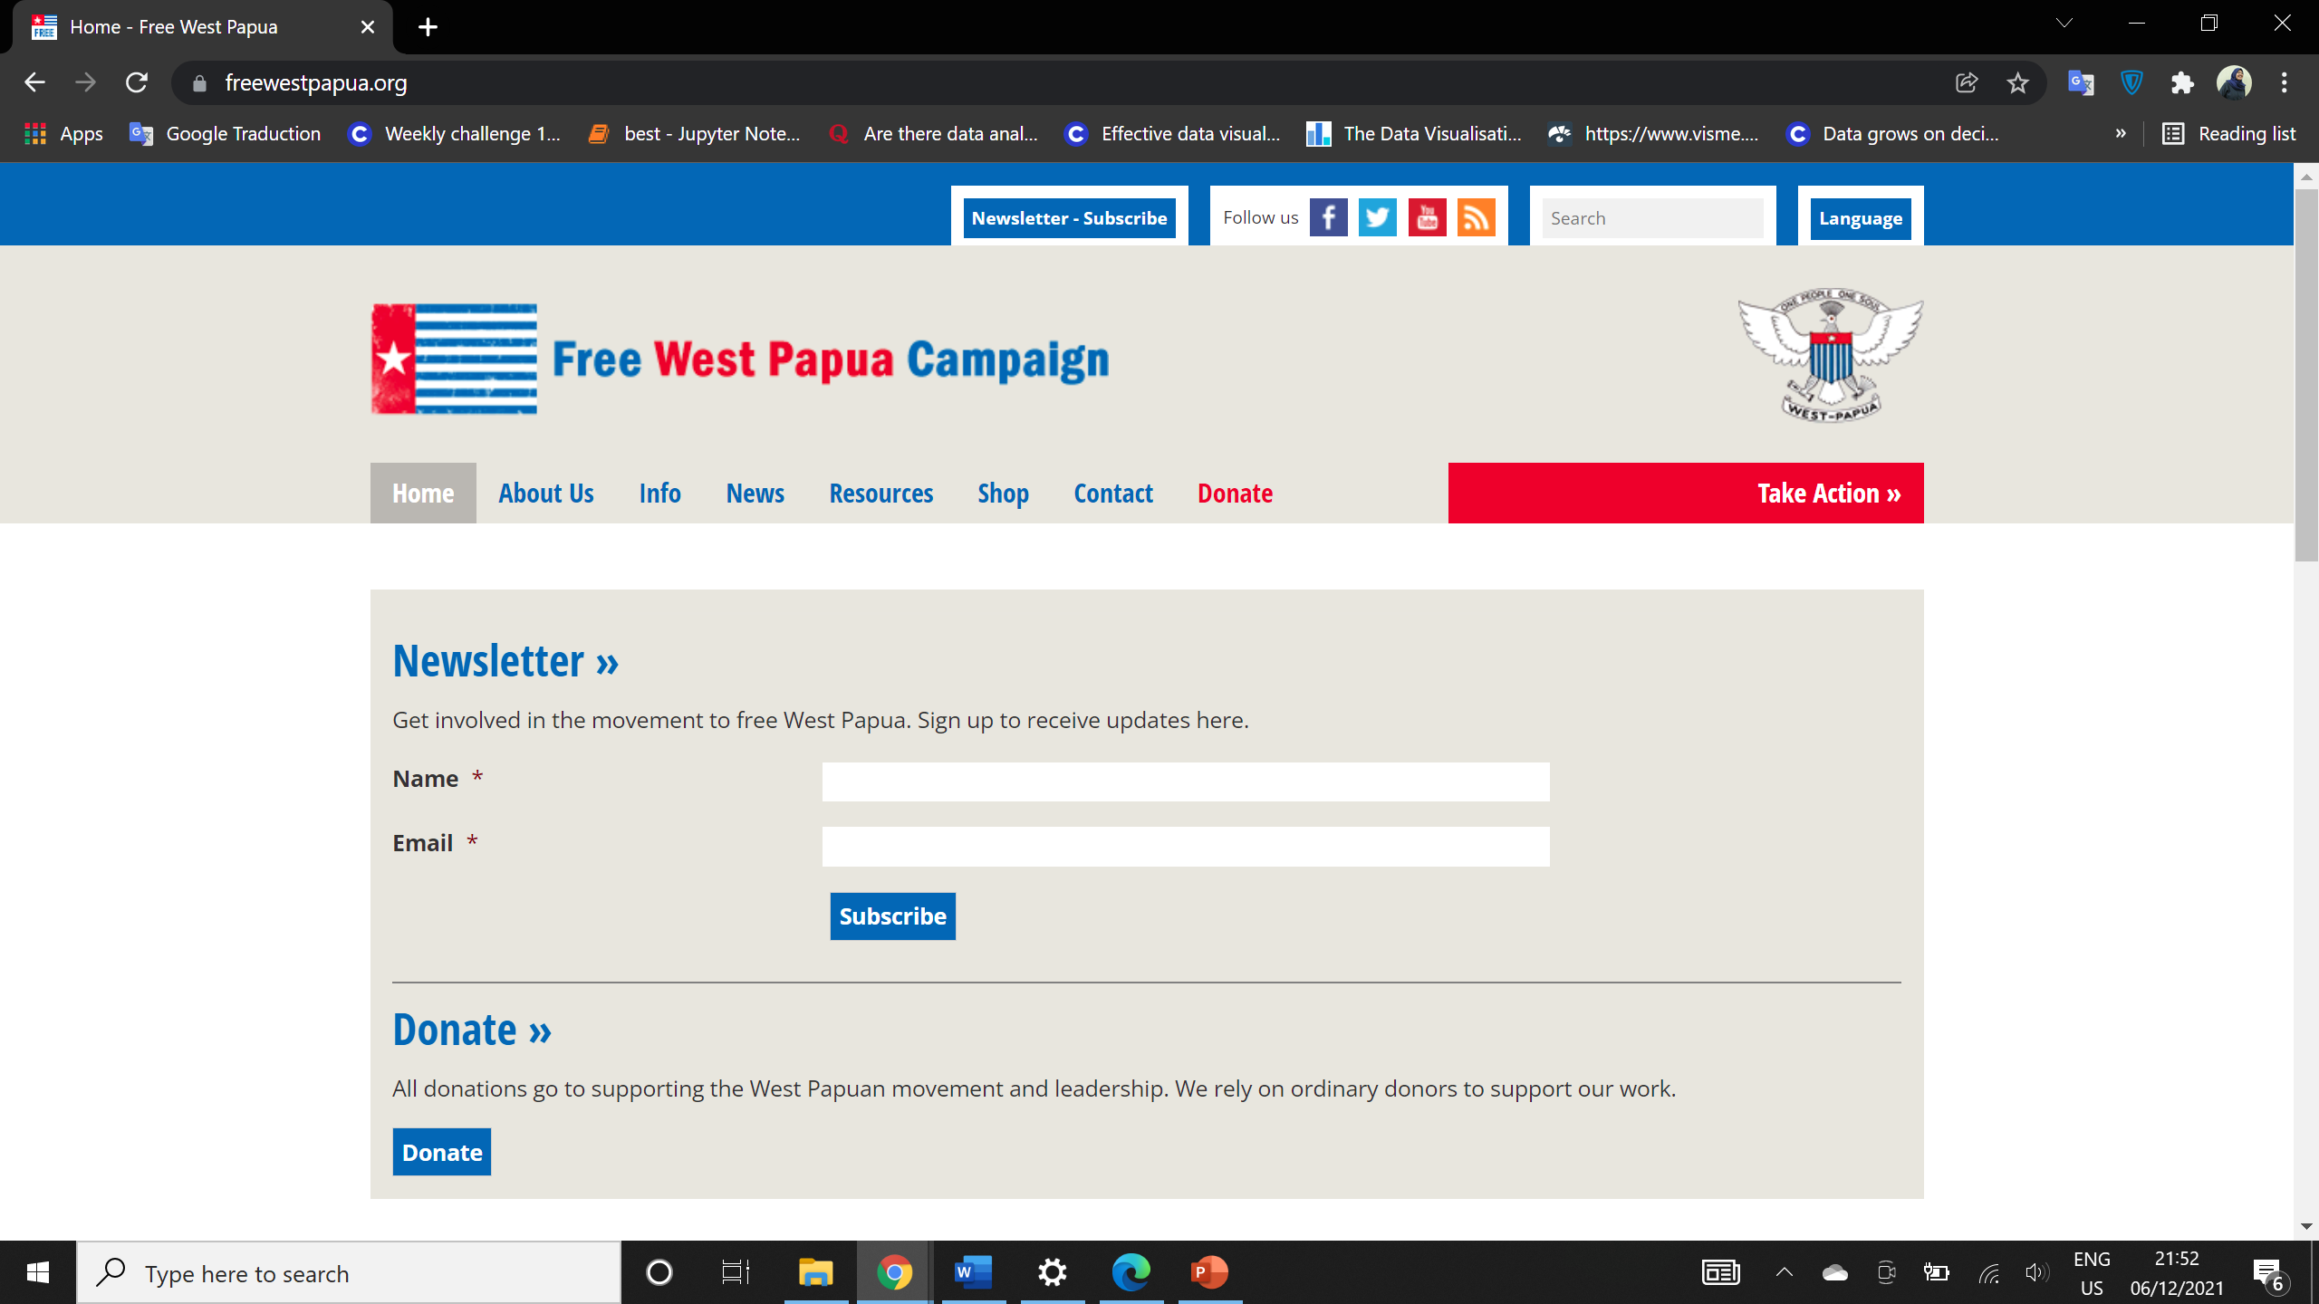

Slide 5
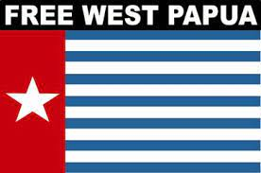
Melanesian Solidarity
Nauru
Marshal island
Tuvalu
Vanuatu
Solomond island
Tonga Palau
The establishment the Melanesian Spearhead Group (MSG) — a subregional grouping founded in 1986 by the leaders of Papua New Guinea, Solomon Islands, Vanuatu, and Fiji.
Support West Papua on UN general assembly

