Slide 1
The Arab countries of the Persian Gulf: participation of women in socio-political transformations
Made by Marina Mkrtchyan
(Faculty of International
Relations, Political and Area
Studies, Master’s Degree
Course, Second Year)

Slide 2
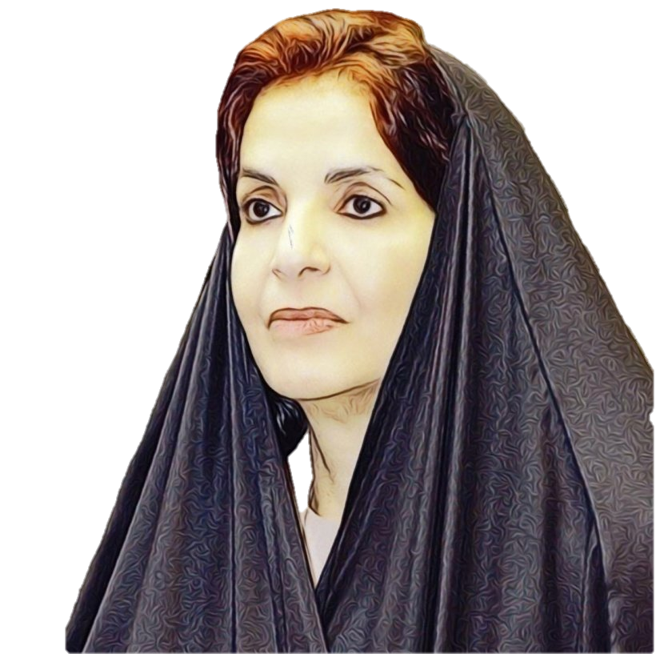
A significant event in the political life of the Kingdom of Bahrain is considered to be the increase in the number of women in the Legislative Council, where 4 women were elected to the Council of Representatives and 11 to the Shura Council.
This event has led to women's confidence in their abilities to contribute to national development in various fields, in particular in the issuance of laws concerning women, the family and society.

Slide 3
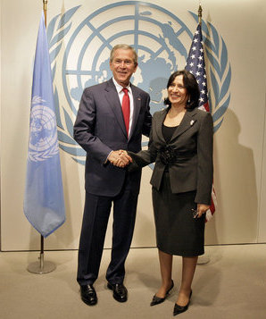
Her Excellency Sheikha Haya Rashid Al Khalifa was elected President of the sixty-first session of the General Assembly on 8 June 2006. Sheikha Haya, who is taking up this position, has had an outstanding legal career both at the national and international level for three decades. As one of the first two women practicing law in her country, she held senior positions in leading legal organizations in the world, including the International Association. She was the Permanent Representative of UNESCO. Defending women's rights, especially in the legal sphere, Sheikha Haya actively participated in the movement aimed at raising the status of women in Bahrain in the Islamic Sharia courts.

Slide 4
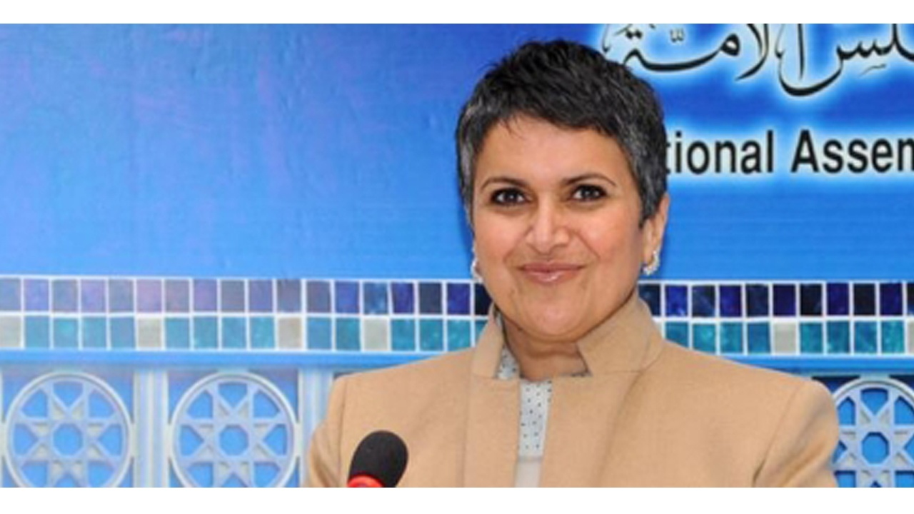
Safa Al Hashem is a politician who was an elected Member of Parliament to the Kuwait Parliament. In Kuwait history, she was the only female member to be elected to the Kuwait parliament consecutively more than two times.

Slide 5
Women's participation in the Council of Ministers has reached the highest level in the world, reflecting the strong position that women in the Emirates have achieved through the empowerment and political integration of women in Government. With regard to the gender distribution of positions in public institutions, women make up 46.6% of the total workforce and they occupy 66% of jobs in the public sector of which 30% occupy managerial positions and 15% occupy technical and academic positions.

Slide 6
Thank you
for your attention!

